Slide 1
"Enhancing Online Security: The Power of Password Generators“
"Creating Strong and Secure Passwords"
Yash Porwal , ( CS-2341534) Mrinalini Maurya, ( CS- 2341526 )
1CSE8
B.TECH Computer Science and Engineering
School of Computer Science and Engineering
IILM University Greater Noida

Slide 2
Contents
1.Objectvie of the Minor Project
2. Project overview(How the objective will be achieved)
3.Flow chart of the project
4.Name of Software Development Life cycle adopted(Waterfall/Prototype/Incremental/Agile/Spiral/Rapid Application Development(RAD). Justification
5.Programming language(s) that will be used(all applicable) for project
6.Applications of the project

Slide 3
Objective
The primary objective of creating a password generator is to enhance online security by providing users with strong, unique, and randomly generated passwords. These passwords are designed to be difficult for attackers to guess or crack, thereby reducing the risk of unauthorized access to sensitive information, accounts, or systems !

Slide 4
Overview
1. Description of the Password Generator Functionality
2. Explanation of the Menu-Driven Interface
3. Brief Overview of the Code Structure

Slide 5
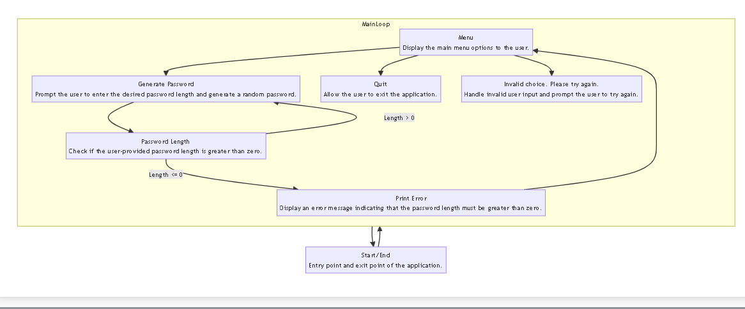
Flowchart

Slide 6
Name of Software Development Life cycle
Agile:
Justification: Agile methodology allows for iterative development and quick adaptation to changing requirements, which is suitable for this project's dynamic nature

Slide 7
Programming language
Python: Utilized for its simplicity, extensive standard library, and readability, making it ideal for rapid application development
-random : for generating string
-string : for providing user choice when generating string

Slide 8
Password generators have numerous applications across various domains:
1. Online Security: Enhancing security for online accounts, including email, social media, banking, and shopping platforms, by generating strong and unique passwords.
2. System Administration: System administrators use password generators to create secure passwords for user accounts, servers, databases, and network devices.
3. Encryption: Generating secure encryption keys for encrypting sensitive data and communications, ensuring confidentiality and integrity.
4. Authentication: Generating one-time passwords (OTP) or temporary passwords for multi-factor authentication (MFA) systems, adding an extra layer of security.
5. Penetration Testing: In cybersecurity assessments, password generators are used to simulate attacks by generating password lists for brute-force or dictionary attacks, helping identify weak passwords.
Overall, password generators play a vital role in safeguarding digital assets and protecting against unauthorized access and cyber threats.

Slide 9
THANK YOU !

